Slide 1
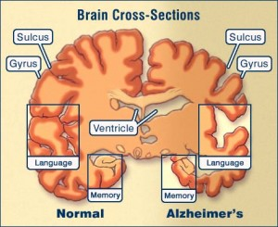
Radiological imaging of dementia.
Dr/ ABD ALLAH NAZEER. MD.

Slide 7
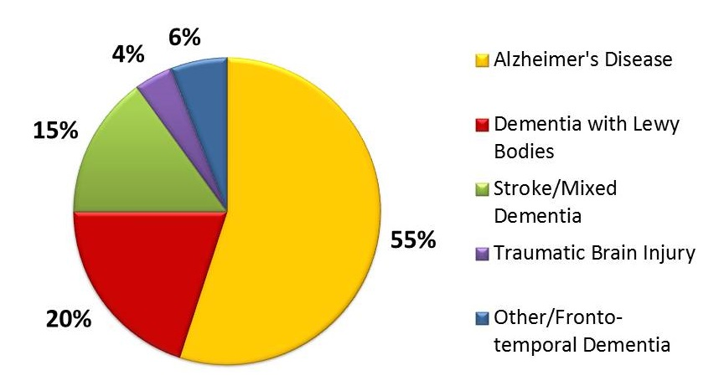

Slide 12
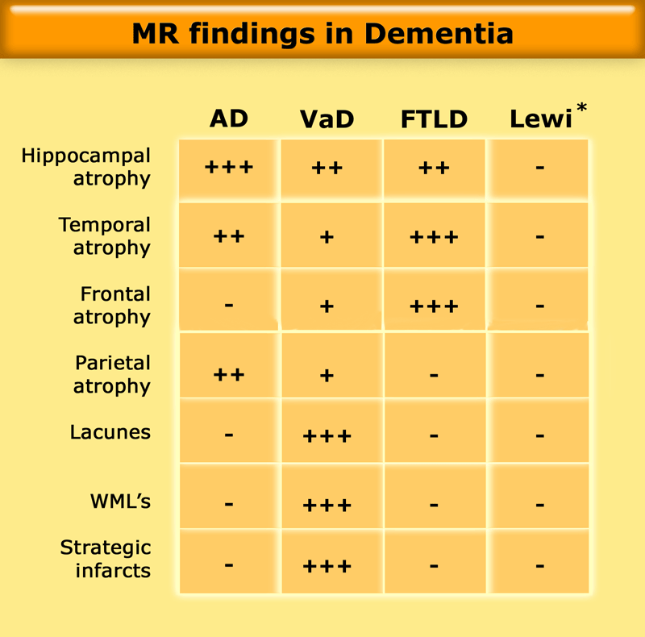

Slide 13
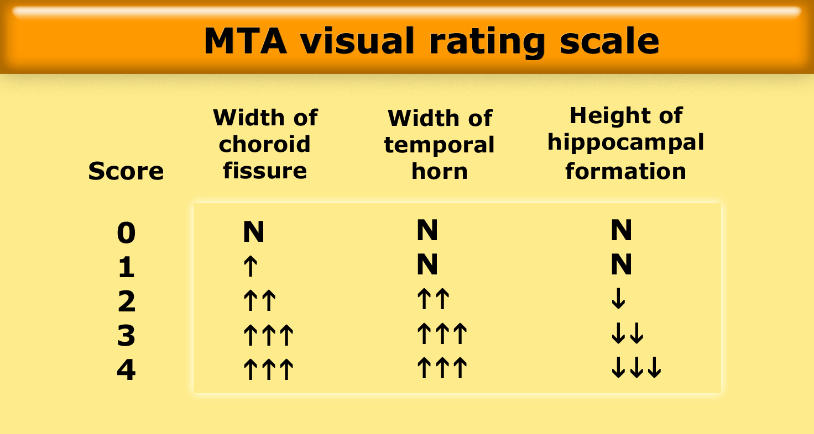
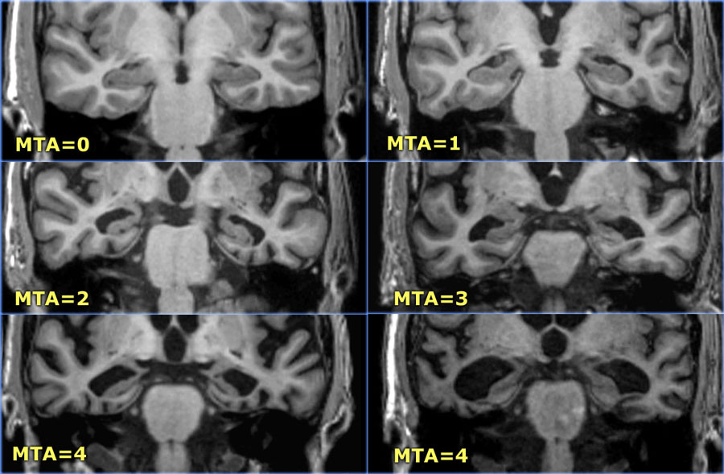

Slide 14
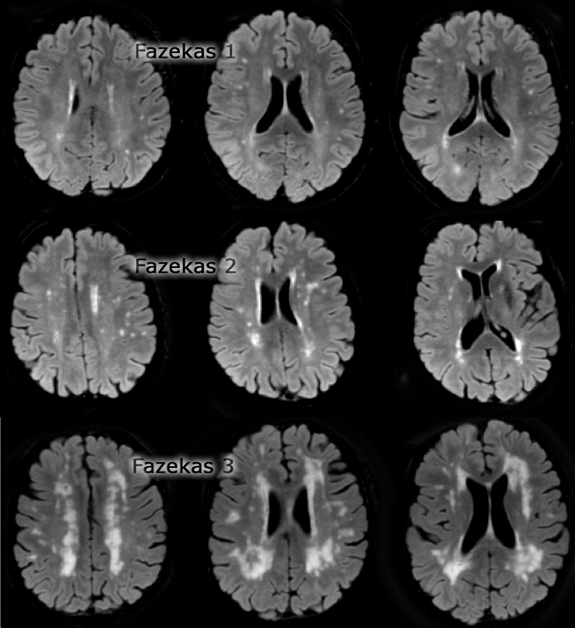
Score:
Fazekas 0: None or a single punctate WMH lesion
Fazekas 1: Multiple punctate lesions
Fazekas 2: Beginning confluency of lesions (bridging)
Fazekas 3: Large confluent lesions

Slide 15
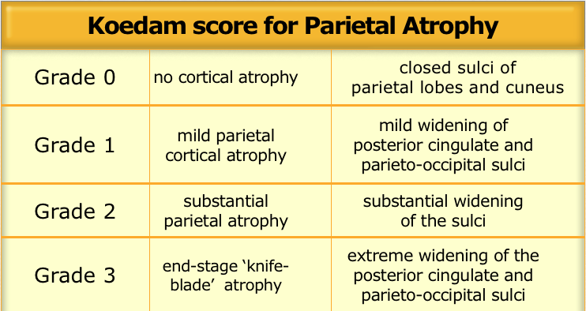

Slide 16
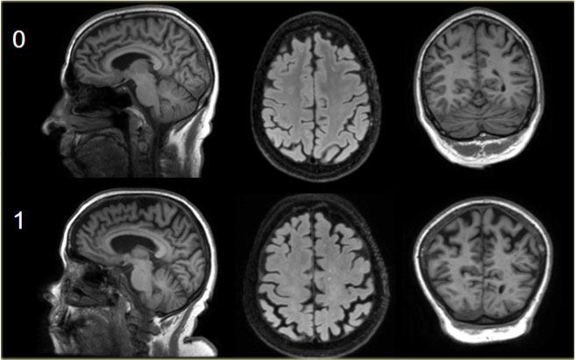
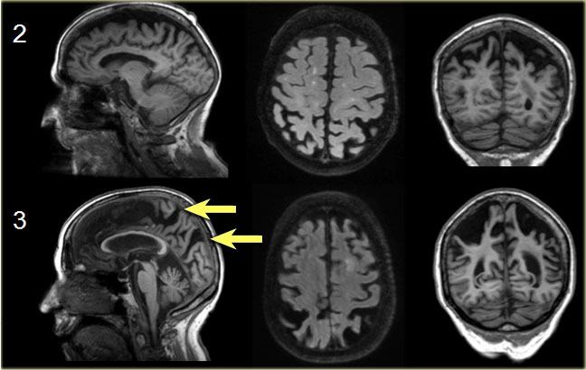
Koedam scale grade 0-1
Koedam scale grade 2-3

Slide 17
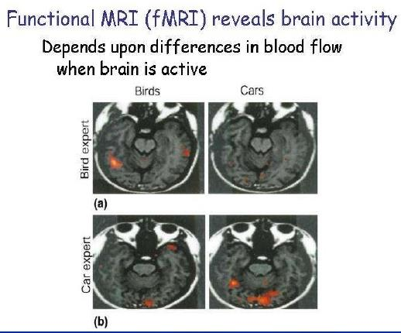

Slide 20
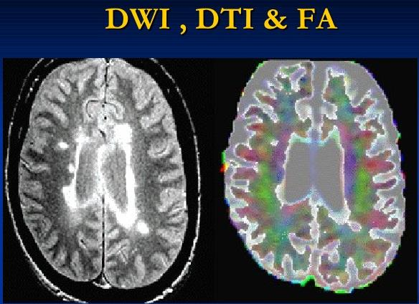

Slide 23
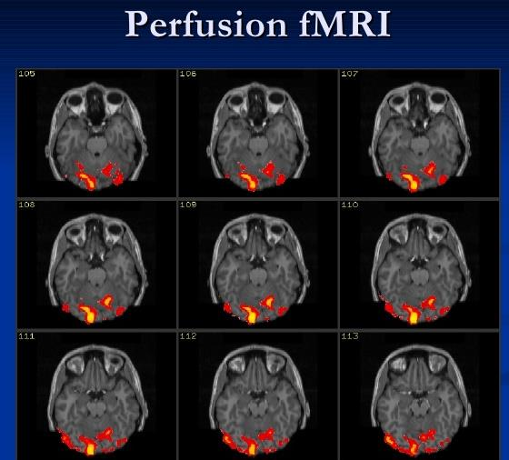

Slide 29
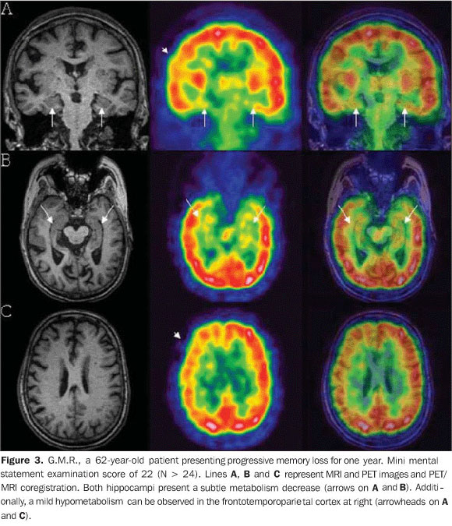

Slide 30
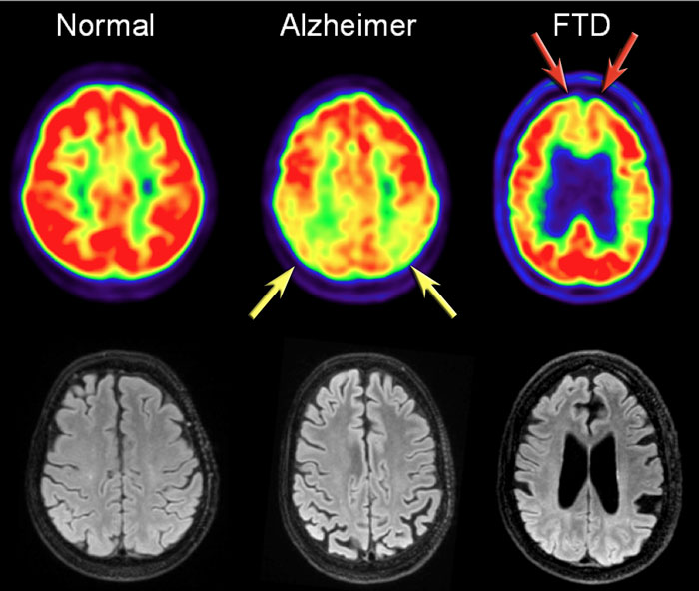
In AD FDG-PET can show hypometabolism in the temporoparietal regions and/or the posterior cingulum. This may help differentiate AD from FTD, which shows frontal hypometabolism on FDG-PET. The images show FDG-PET and axial FLAIR images of a normal subject and of patients with AD and FTD. FDG-PET (top row) and axial FLAIR images of a normal subject and of AD and FTD patients. In AD there is a decreased metabolism of the parietal lobes (yellow arrows), whereas in FTD, there is frontal hypometabolism (red arrows).

Slide 35
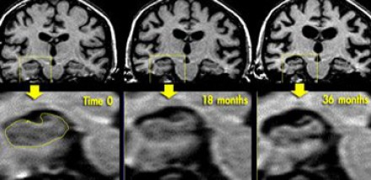
Coronal T1WI of the hippocampus demonstrating progressive atrophy in familial AD

Slide 36
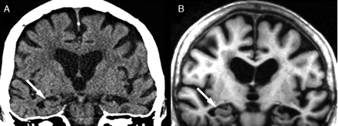
Bilateral medial temporal lobe atrophy (right hippocampus illustrated with arrows) in the same subject with Alzheimer’s disease demonstrated on coronal images acquired with: (A) 64 detector row computed tomography scanning; (B) 1.5 tesla MRI volumetric T1 weighted sequence

Slide 37
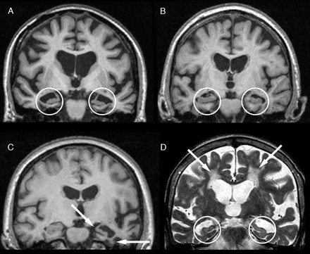
T1 weighted coronal volumetric MRI at 1.5 T, showing symmetrical medial temporal lobe (MTL) atrophy (circled) in postmortem proven Alzheimer’s disease; (B) T1 weighted coronal volumetric MRI at 1.5 T. showing relative sparing of MTL structures (circled) in postmortem proven dementia with Lewy bodies; (C) T1 weighted coronal volumetric MRI at 3 T, showing highly asymmetric inferior left temporal lobe and hippocampal atrophy (arrows) in front temporal lobar degeneration, semantic dementia subtype; (D) T2 weighted coronal volumetric MRI at 1.5 T, showing symmetrical MTL atrophy (circled) and small vessel white matter disease (arrows) in a patient with clinically diagnosed mixed vascular/Alzheimer’s disease .

Slide 38
Axial FLAIR MRI showing left hippocampal swelling and hyperintensity (arrow) in voltage gated potassium channel complex antibody associated limbic encephalitis; (B) Axial diffusion weighted MRI in a patient with sporadic Creutzfeldt-Jakob disease demonstrating widespread areas of confluent bilateral cortical restricted diffusion with similar restricted diffusion in the caudate nuclei and left putamen; (C) axial gradient—echo T2* weighted imaging demonstrates multiple microbleeds (examples circled) indicating cerebral amyloid angiopathy in a patient with familial Alzheimer’s disease.

Slide 39
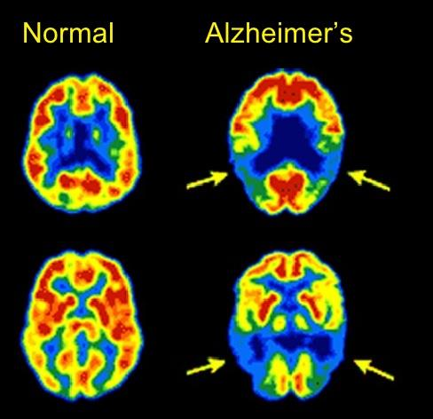

Slide 40
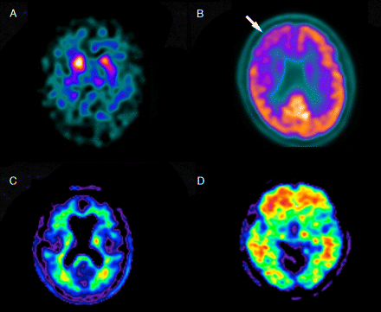
Dopamine transporter imaging shows symmetrical reduced basal ganglia uptake (dot-like, rather than comma-like, in appearance) in a patient with clinically probable dementia with Lewy bodies; (B) FDG-PET shows right frontotemporal hypometabolism (arrow) in a patient with clinically probable behavioural variant frontotemporal dementia. Warm colors represent high glucose uptake; (C, D) F18 (florbetapir) amyloid PET imaging shows absence of significant binding in (C) a normal control; and (D) significant amyloid deposition (warm/hot colours) in a patient with clinically diagnosed Alzheimer’s disease.

Slide 41
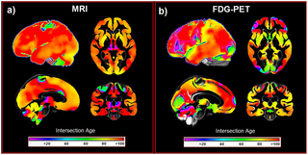
Voxel-wise intersections of healthy aging and changes observed in AD in MRI (a) and FDG-PET (b). Colour bars represent the intersection age. AD Alzheimer's disease, FDG-PET [18F]fluorodeoxyglucose positron emission tomography.

Slide 43
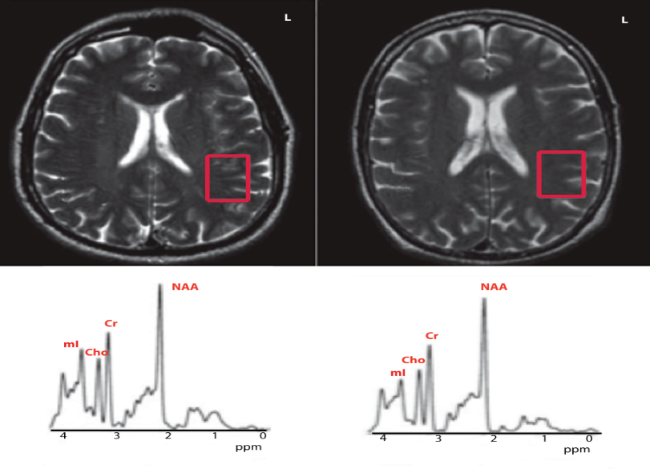
MRS in Alzheimer Disease Axial T2-weighted images from an AD patient (L, left) and a healthy control (R, right). These images show the left elevated NAA, Cr/PCr, Cho containing compounds, Glu and mI. Most authors have opted for following up AD .

Slide 44
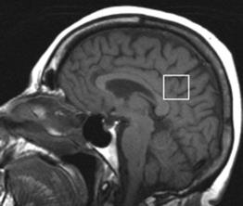
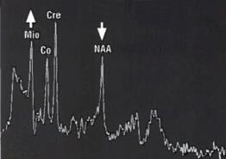
Reduced NAA and NAA / Cr (reduction of neuronal population); Increased mI and mI / Cr (presence of glial repairers phenomena); The reason mI / NAA is considered the most reliable in the assessment of metabolites in Alzheimer's disease.

Slide 45
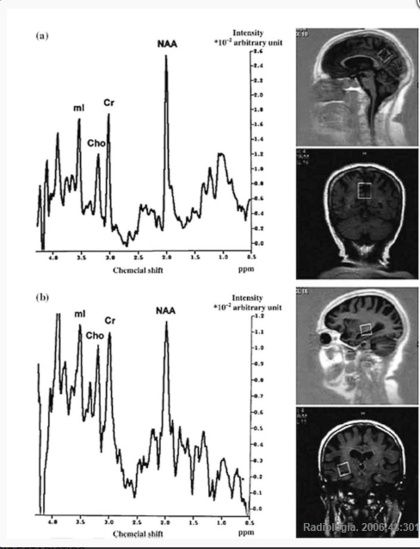
Magnetic resonance spectroscopy (MRS) in Alzheimer's disease.

Slide 49
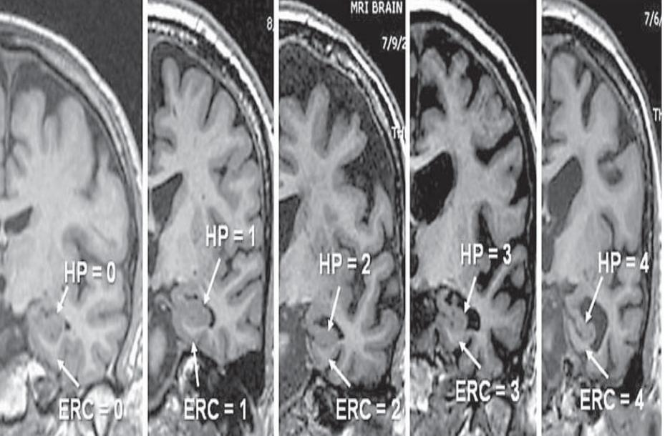
Lewy bodies, and corticobasal degeneration. Therefore we can say that medial temporal lobe atrophy is a important tool for diagnosis .

Slide 52
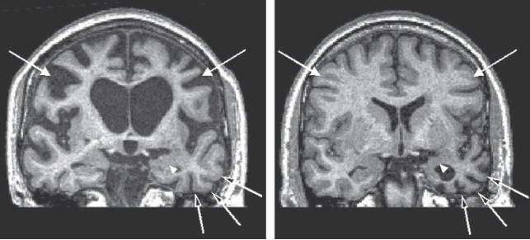
Frontotemporal dementia (FTD). Coronal MRI sections from one patient with frontally predominant FTD (left) and another with temporally predominant FTD (right). Prominent atrophy affecting the frontal gyri (white arrows) is present in frontally predominant FTD, particularly affecting the right frontal region; note also the thinning of the corpus callosum superior to the lateral ventricles. This patient presented with disinhibition and antisocial behavior. In the temporally predominant patient, severe atrophy in the left temporal lobe (open arrows) and amygdala (white arrowheads) is present; this patient presented with progressive aphasia

Slide 53
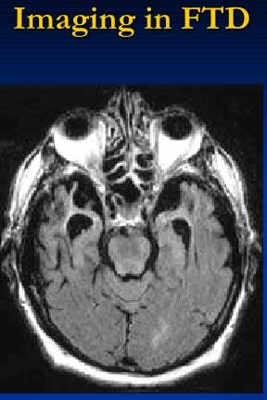
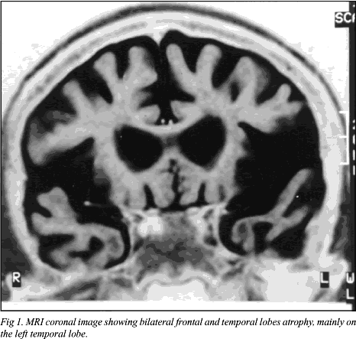

Slide 55
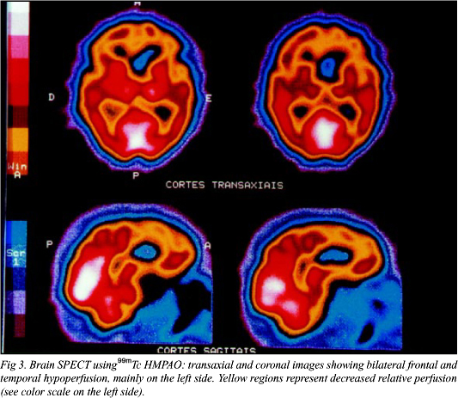

Slide 56
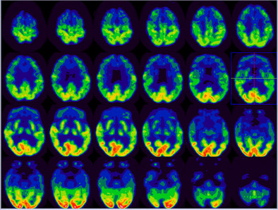
Frontotemporal dementia, there is severely reduced FDG activity in the bilateral anterior temporal, bilateral frontal, and bilateral anterior parietal regions. Mild to moderate to decreased FDG uptake is most noted in mid to posterior temporal and regions. This finding is consistent with frontotemporal dementia.

Slide 58
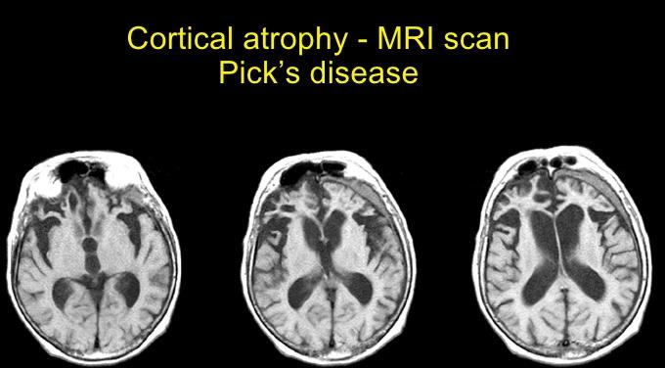

Slide 59
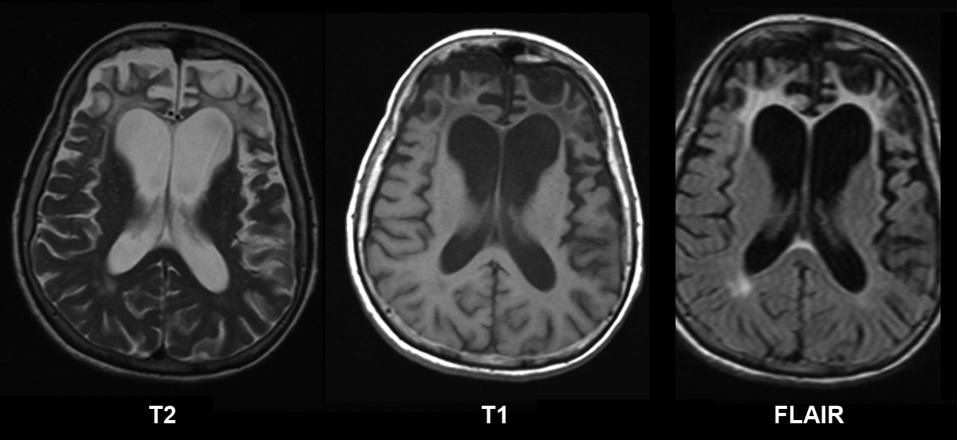
Pick's disease with cortical atrophy.

Slide 60
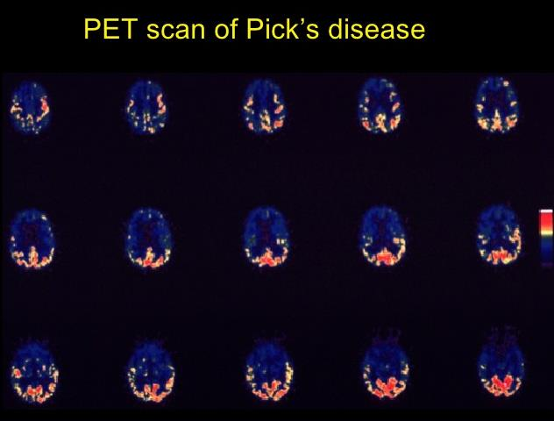

Slide 64
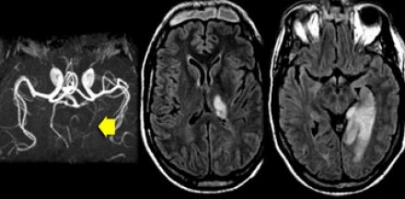
Acute PCA infarction involving the medial temporal lobe with dementia.

Slide 65
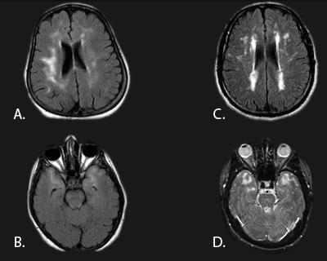
Vascular dementia with white matter leukoencephalopathy.

Slide 66
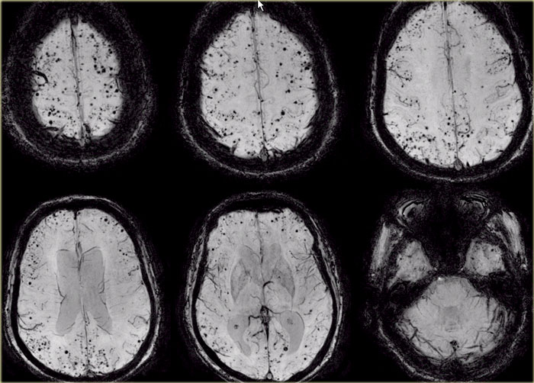
T2* images demonstrate multiple lobar microbleeds in a patient with CAA.

Slide 67
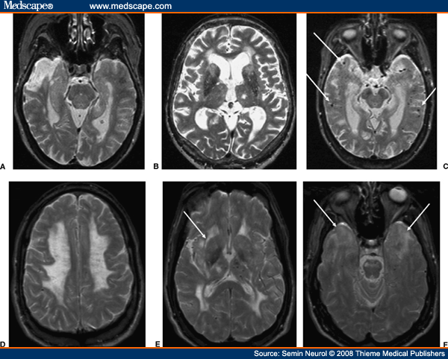
Vascular dementia with white matter ischemia.

Slide 68
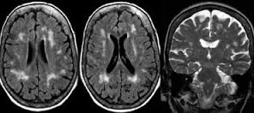
Vascular dementia with white matter chronic low grade ischemia.

Slide 70
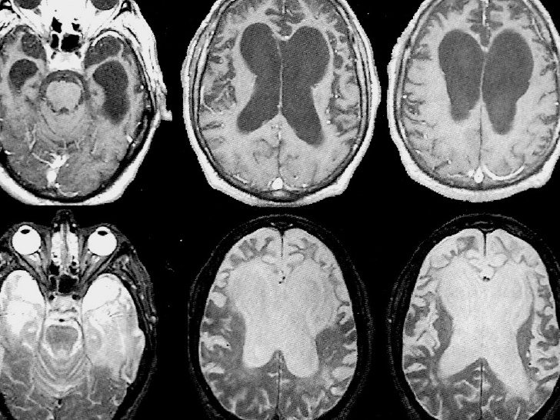

Slide 71
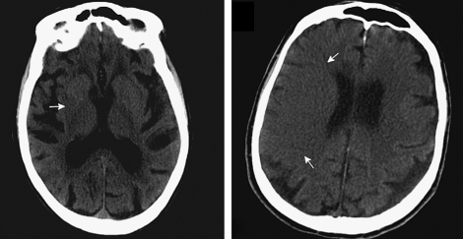
Cerebral ischemia with dementia

Slide 72
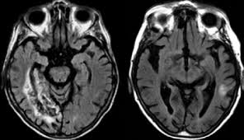
Cerebral ischemia with dementia.

Slide 73
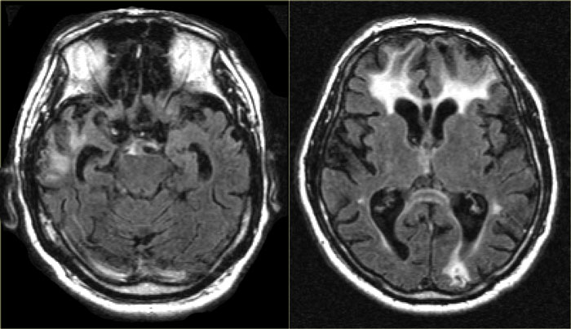
Traumatic brain injury with dementia.

Slide 74
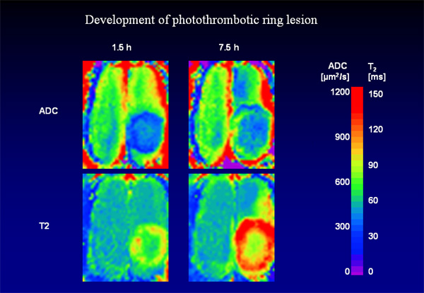
Chronic cerebral ischemia with dementia.

Slide 75
Creutzfeldt-Jakob disease (CJD)
CJD is a very rare and incurable neurodegenerative disease, caused by a unique type of infectious agent called a prion. The first symptom of CJD is rapidly progressive dementia, leading to memory loss, personality changes and hallucinations. The disease is characterized by spongiform changes in the cortical and subcortical gray matter, with loss of neurons and replacement by gliosis. The abnormalities can sometimes be detected on FLAIR, but are most conspicuous on DWI sequences, affecting either the striatum, the neo-cortex, or a combination of both.
New variant CJD New variant of CJD is also known as the 'mad cow disease. It is a disease fortunately hardly encountered anymore. In this variant the changes are seen in the posterior part of the thalamus, called the pulvinar.

Slide 76
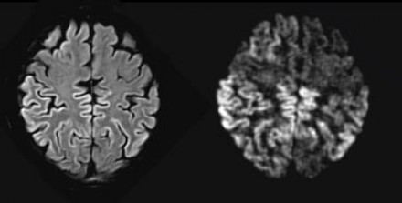
Changes in the neocortex as seen on FLAIR (left) and DWI (right) with dementia.

Slide 77
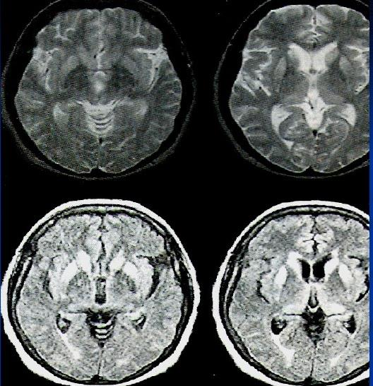
Prion Disease

Slide 78
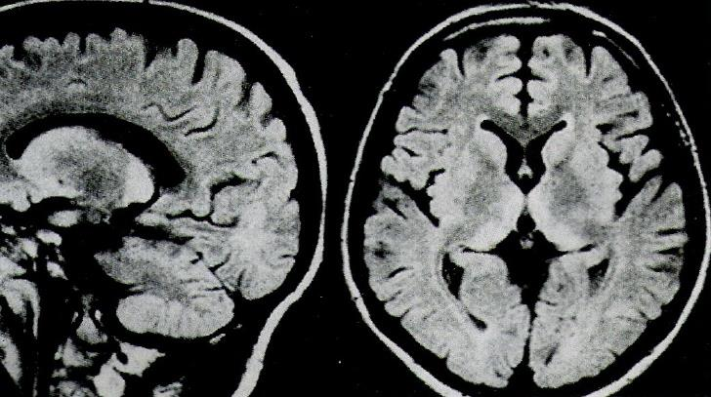
Prion Disease

Slide 79
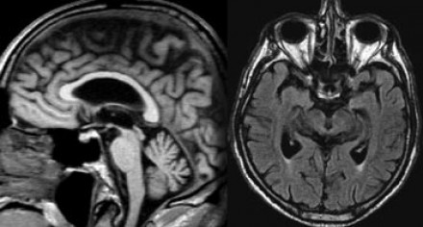
Progressive supranuclear palsy (PSP)
PSP is also one of the atypical parkinsonian syndromes. In PSP there is pronounced atrophy of the midbrain (mesencephalon), which accounts for the typical upward gaze paralysis.
PSP with midbrain atrophy and dementia.

Slide 80
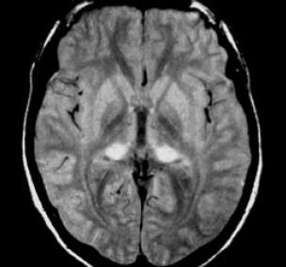
Pulvinar hyperintensity in new variant of CJD with dementia.

Slide 82
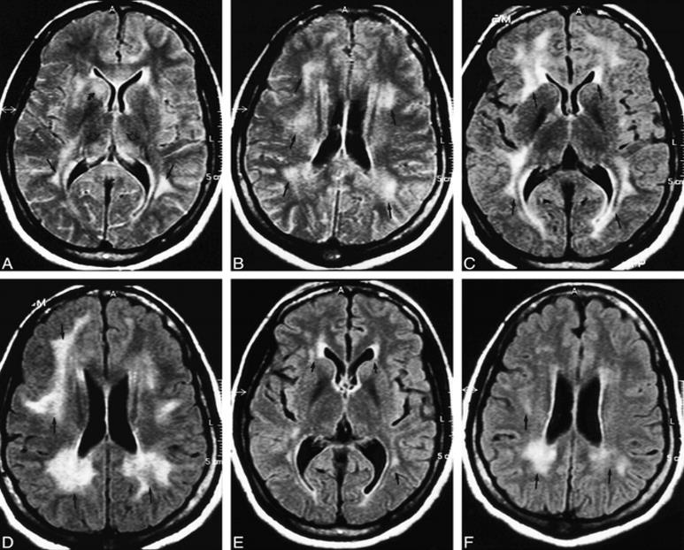
AIDS Dementia Complex:

Slide 83
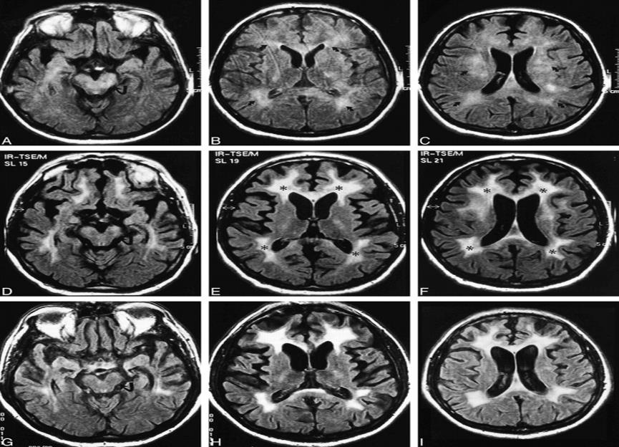
AIDS Dementia Complex:

Slide 85
Thank You.

